Slide 1

DROPSHIPPING
PRESENTATION
BY HARPREET CHAUHAN, UID=24BCA10463, SECTION=7A

Slide 2

WHAT IS DROPSHIPPING?
Dropshipping is a simple enough concept: You set up an eCommerce store and use suppliers to fulfill your orders and ship them out to your customers.
This retail fulfillment method means that the merchant doesn't have to handle or deal with the product.
Dropshipping is designed so the merchant doesn't have to store any inventory and there is no worrying about any logistics or shipping costs

Slide 3
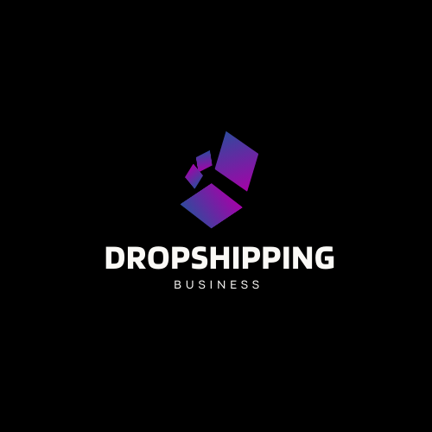
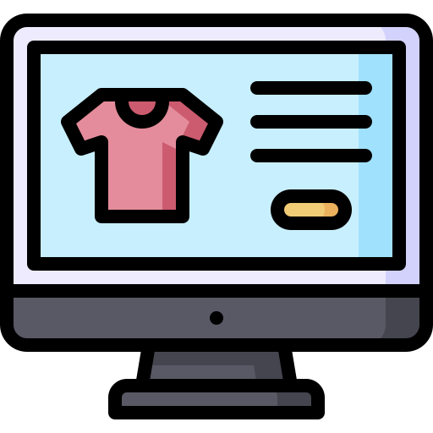


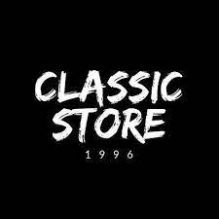
1 - The customer orders and pays you for the product.
2- Only after you get the money from the customer will you pay the supplier to fulfill the order.
3- The supplier ships the product directly to the customer.
CLASSIC
1 - You get the items from the supplier. You also pay them at this time.
2- The customer orders and pays you for the product.
3 - You ship the order to the customer.
DROPSHIPPING

Slide 4
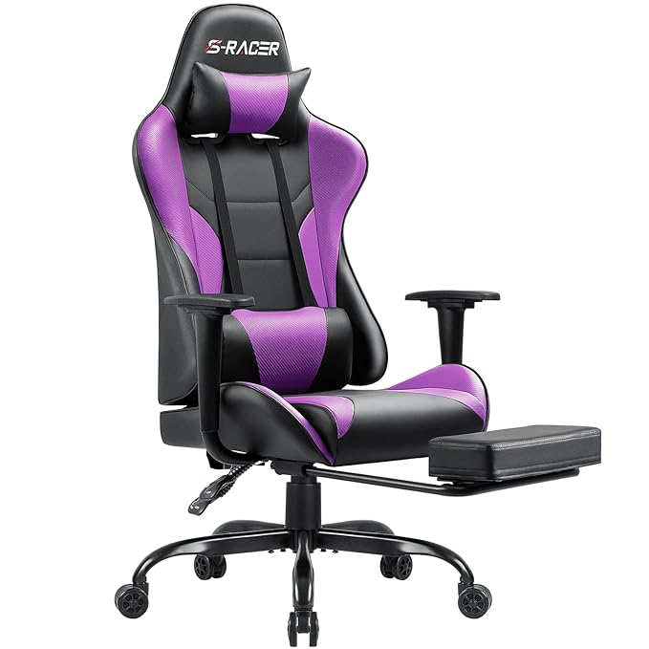
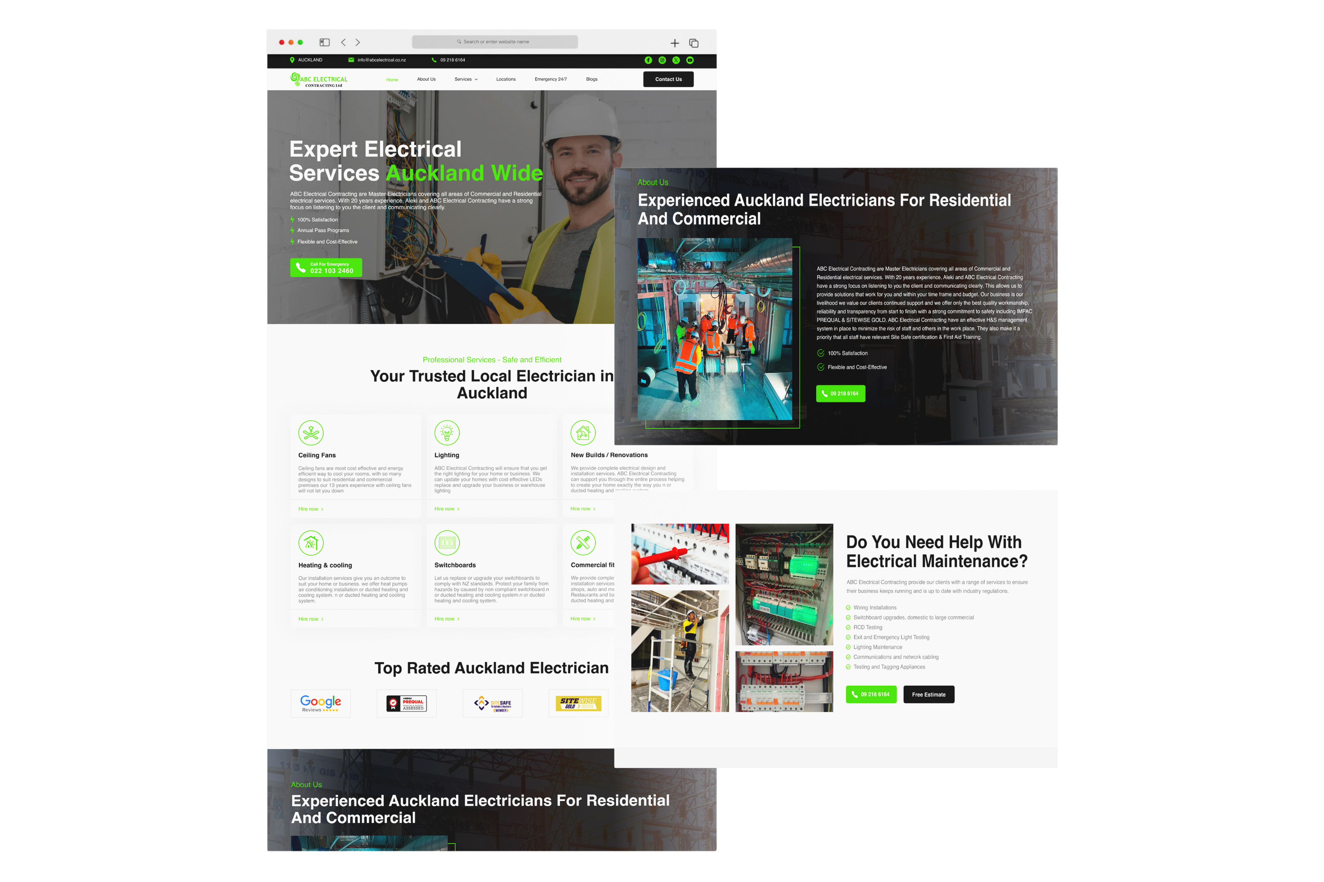
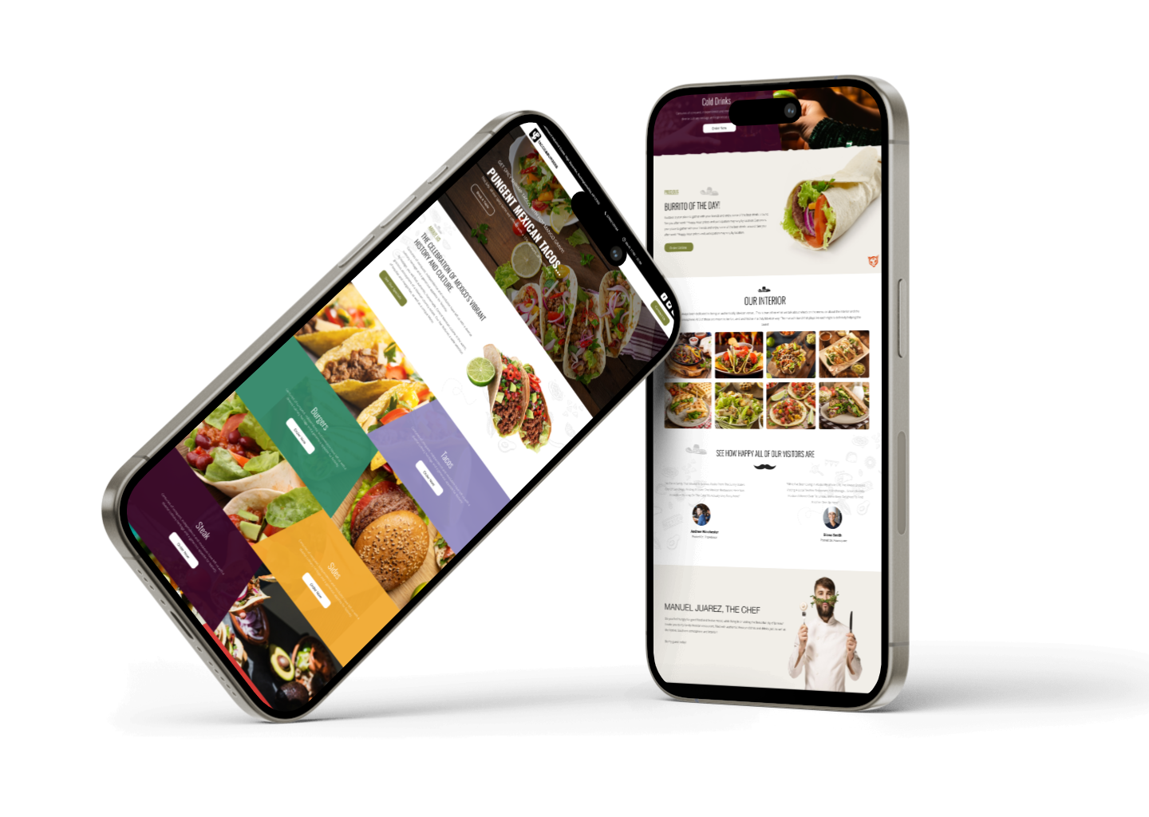
EXAMPLE OF DROPSHIPPING
Rahul wanted to start his own business of chairs, but he didn't have space to maintain the stock or neither had a lot of money to buy chair stock in advance. He researched on google how to go ahead with this kind of situation and found out about the dropshipping business model. He found that interesting and decided to start his own dropshipping business.
He created his own E-commerce Store to sell chairs and tie-up with one of the chair vendors, and now, when someone orders a chair on his website, he simply purchases the goods from that vendor and ships them directly to customers.
By doing this, he solved his two problems. One is he saved a lot of money as he didn't need to purchase goods in advance, and the second is the space problem. Now he doesn't require any space to maintain the stock.

Slide 5
INVESTMENT REQUIRED FOR DROPSHIPPING
The Basic investment that is required to start dropshipping is 250 USD. When you scale up, you will have to invest more. The following four things are essential for any dropshipping business.
1.Dropshipping Platform Fees
Shopify Basic Plan 29 USD [per Month]
2. Domain Cost
On average, it will cost 10-12 USD
3. Product Samples
100 USD
4. Marketing
100 USD

Slide 6
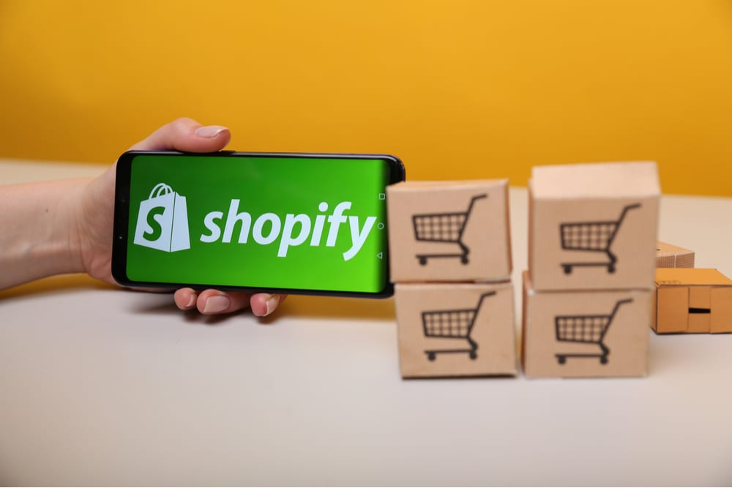


Best E-commerce Platform for Dropshipping
The best dropshipping platforms for 2020 are not necessarily the same as they will be in 2024, so it's important to take note of them now and get an idea about what will happen by then. Here are three platforms you should consider for your future dropshipping business.

Slide 7

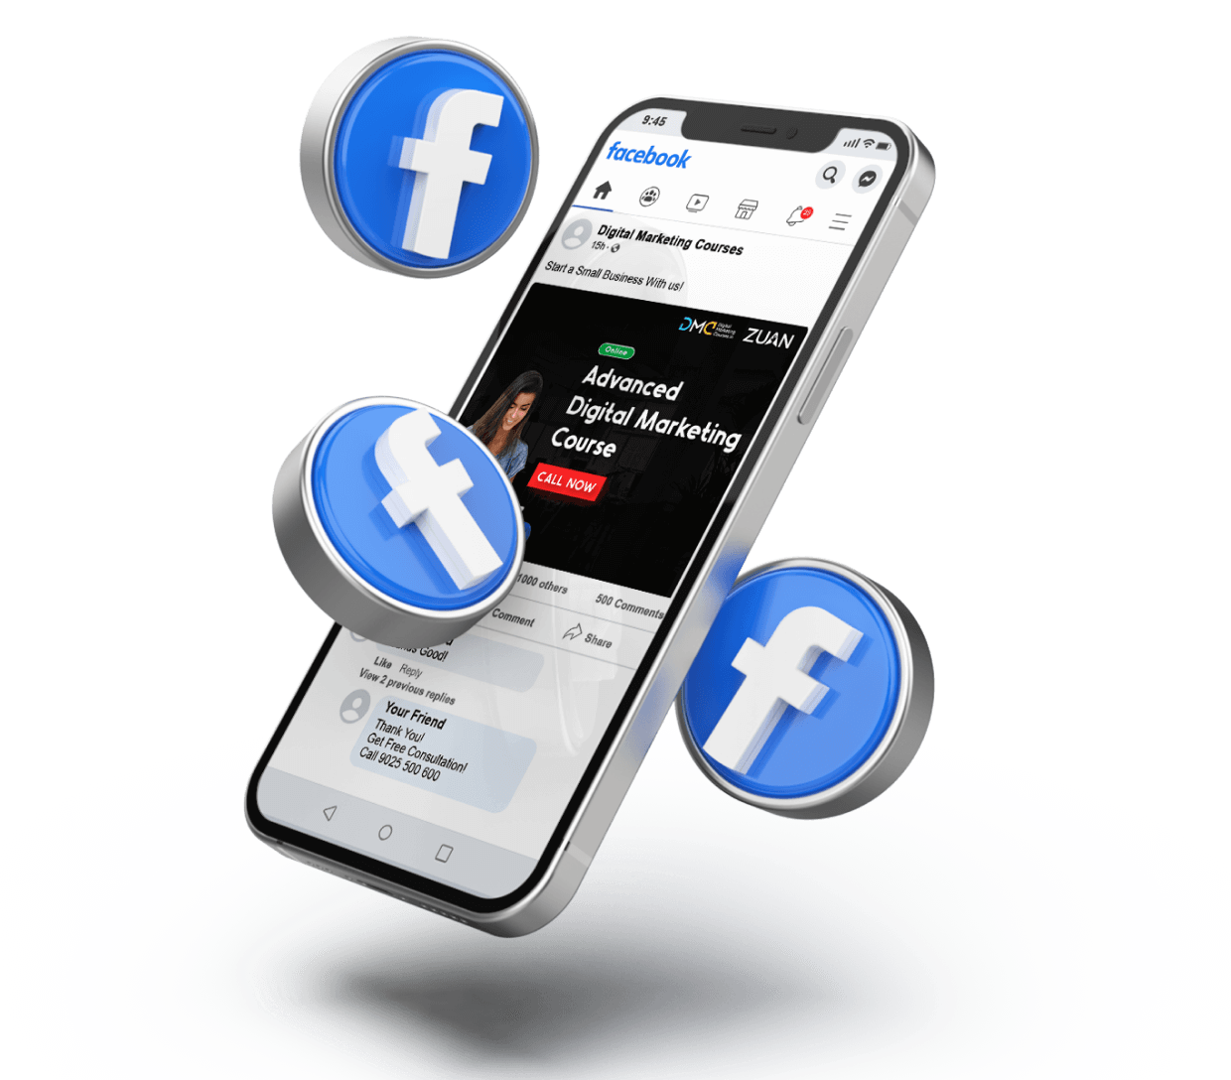
TIPS TO GROW YOUR DROPSHIPPING BUSINESS
1) Create an attractive store
2) Focus on Marketing
4) List Unique Products in your store
5) Add Customer Reviews
3) Customer support
6) Test your Products

Slide 8



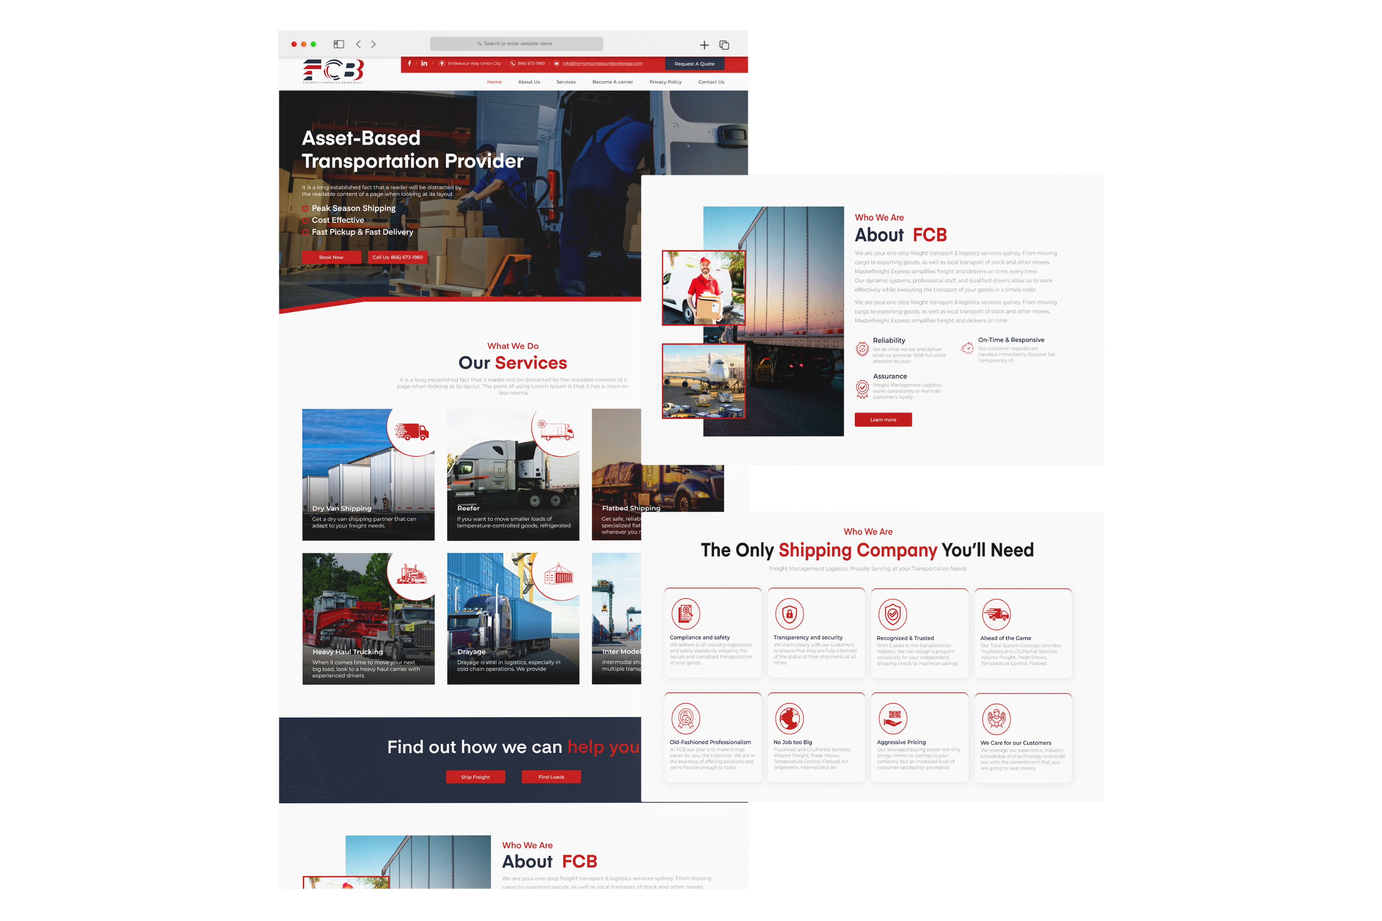

CREATE AN ATTRACTIVE WEBSITE WITH STRONG UI/UX:
Logo: Simple, memorable, scalable, and aligned with brand colors.
Banner: High-quality image, clear message, readable text, and a bold CTA.
Color & Fonts: Consistent color palette, readable font pairing, and clear text hierarchy.
Navigation: Simple, intuitive, and mobile-friendly with clear menu items.
Footer: Key links, social icons, contact info, and optional newsletter CTA.
Layout: Clean grid-based design with ample white space for readability.
Imagery & Icons: High-quality, relevant images and simple, intuitive icons.
Accessibility: Good color contrast, alt text for images, and keyboard-friendly navigation.
Responsive Design: Mobile-optimized layout with scalable elements.
Testing: Conduct user and A/B testing to refine and improve the site experience.

Slide 9

THANK YOU

